Slide 1

Chapter 7
Transmission Media
School of Computer Science and Engineering
Pusan National University
Jeong Goo Kim

Slide 2
Ch. 7 Outline
    Outline
7.1 Introduction
7.2 Guided Media
7.3 Unguided Media

Slide 3
    Ch. 7 Objective
    Objective
Guided Media
  twisted-pair cables
  coaxial cables
Unguided Media
  radio waves
  microwaves

Slide 4

    7.1 Introduction
    7.1 Introduction
Transmission media are actually located below the physical layer and are directly controlled by the physical layer.
They belong to layer zero
Fig. 7.1 Transmission media and physical layer

Slide 5
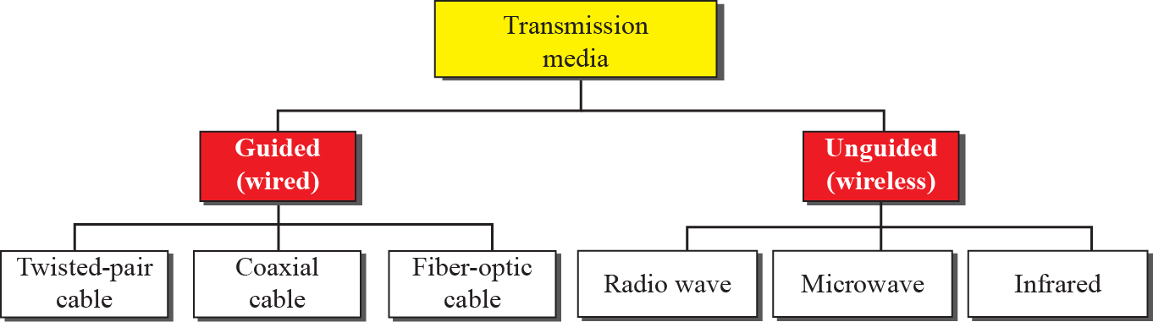
    7.1 Introduction
Fig. 7.2 Classes of Transmission media

Slide 6

    7.2 Guided Media
    7.2 Guided Media
provide a conduit from one device to another.
twisted-pair cable, coaxial cable, and fiber-optic cable.
7.2.1 Twisted-Pair Cable
Two wires
  one carry signal the other is used as a ground reference
Fig. 7.3 Twisted-pair cable

Slide 7
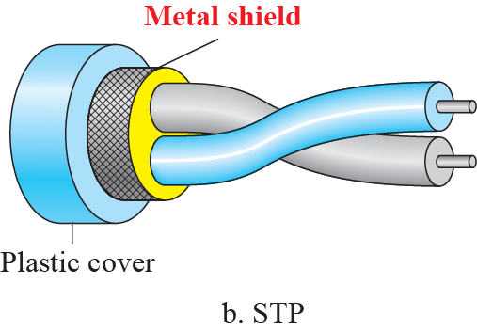
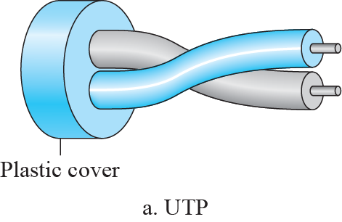
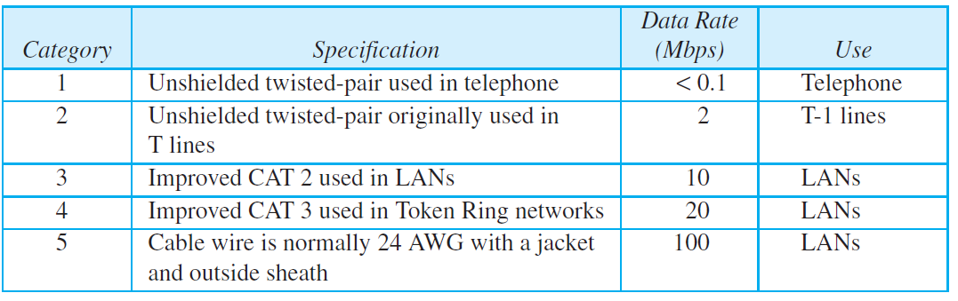
    7.2 Guided Media
Fig. 7.4 UTP and STP cables
Table 7.1 Categories of unshielded twisted-pair cables

Slide 8

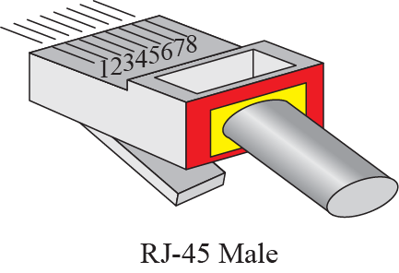
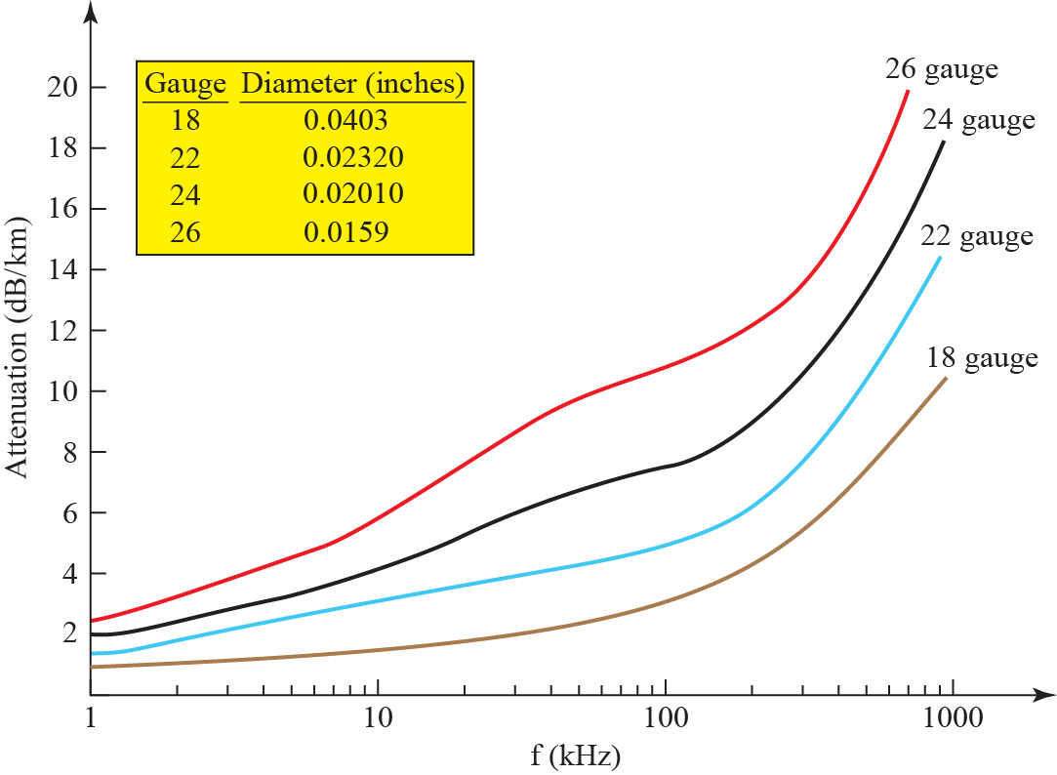
    7.2 Guided Media
Fig. 7.5 UTP Connectors
Fig. 7.6 UTP Performance

Slide 9
    7.2 Guided Media
Applications
DSL
LAN
  10Base-T (10 Mbps Baseband Twister-pair)
  100Base-T (100 Mbps Baseband Twister-pair)

Slide 10
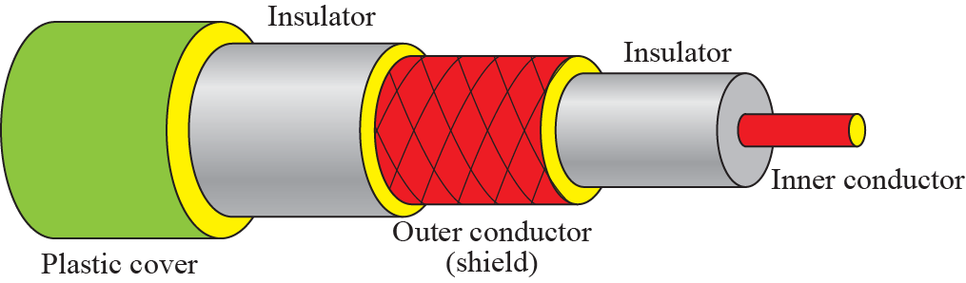
    7.2 Guided Media
7.2.2 Coaxial Cable
carries signals of higher frequency ranges than those in twisted pair cable
has a central core conductor of solid or stranded wire (usually copper) enclosed in an insulating sheath
Fig. 7.7 Coaxial cable

Slide 11
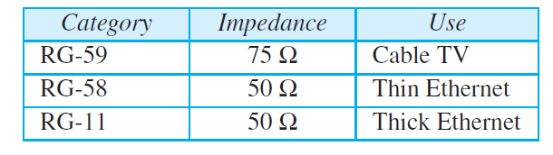
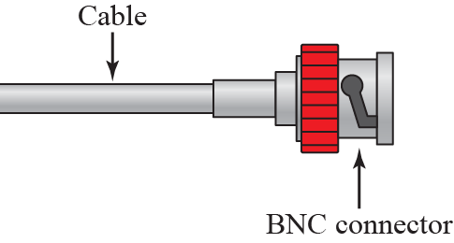
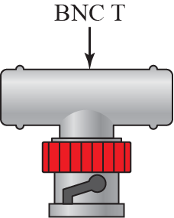
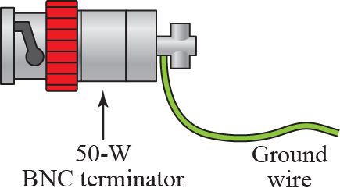
    7.2 Guided Media
Table 7.2 Categories of Coaxial Cable
Fig. 7.8 BNC connectors

Slide 12
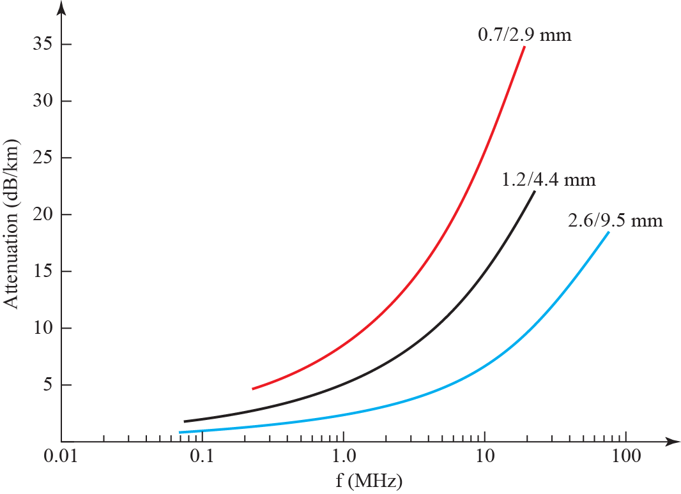
    7.2 Guided Media
Performance
Fig. 7.9 Coaxial cable performance

Slide 13
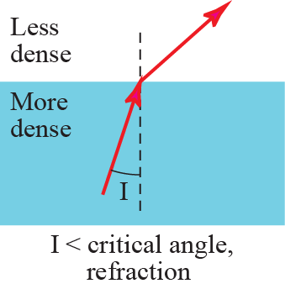
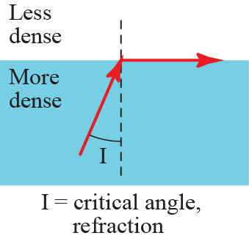
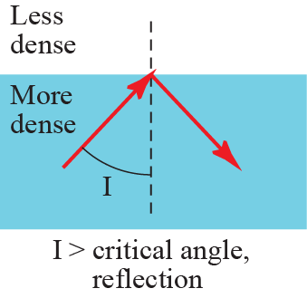
    7.2 Guided Media
7.2.3 Fiber-Optic Cable
is made of glass or plastic and transmits signals in the form of light.
Fig. 7.10 Banding of light ray

Slide 14
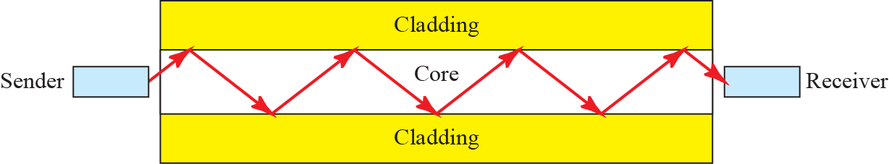
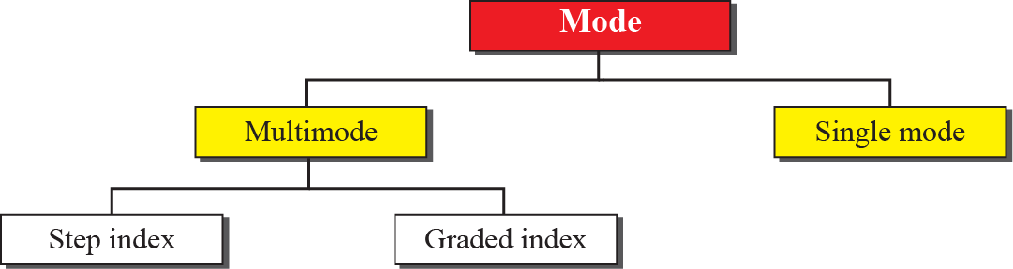
    7.2 Guided Media
Fig. 7.11 Optical Fiber
Fig. 7.12 Propagation Modes

Slide 15



    7.2 Guided Media
Fig. 7.13 Modes

Slide 16
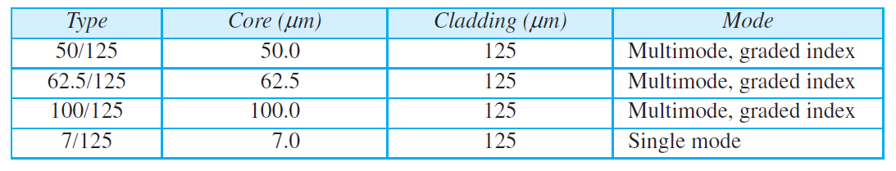
    7.2 Guided Media
Table 7.3 Fiber types

Slide 17
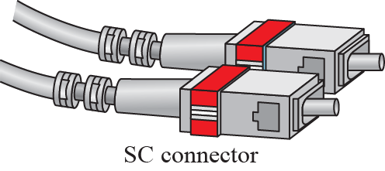
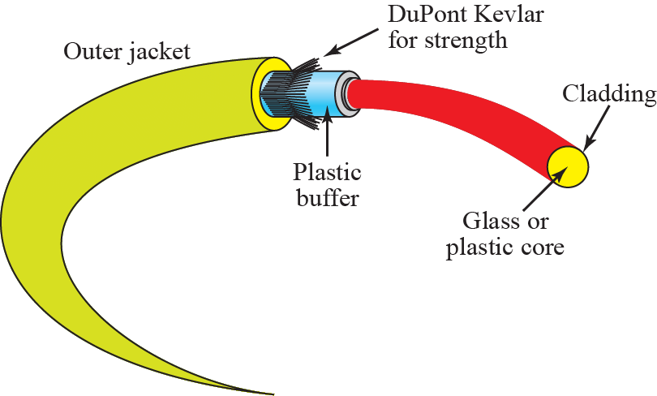

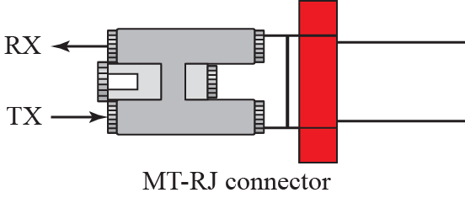
    7.2 Guided Media
Fig. 7.14 Fiber connection
Fig. 7.15 Fiber-optic cable
connector

Slide 18
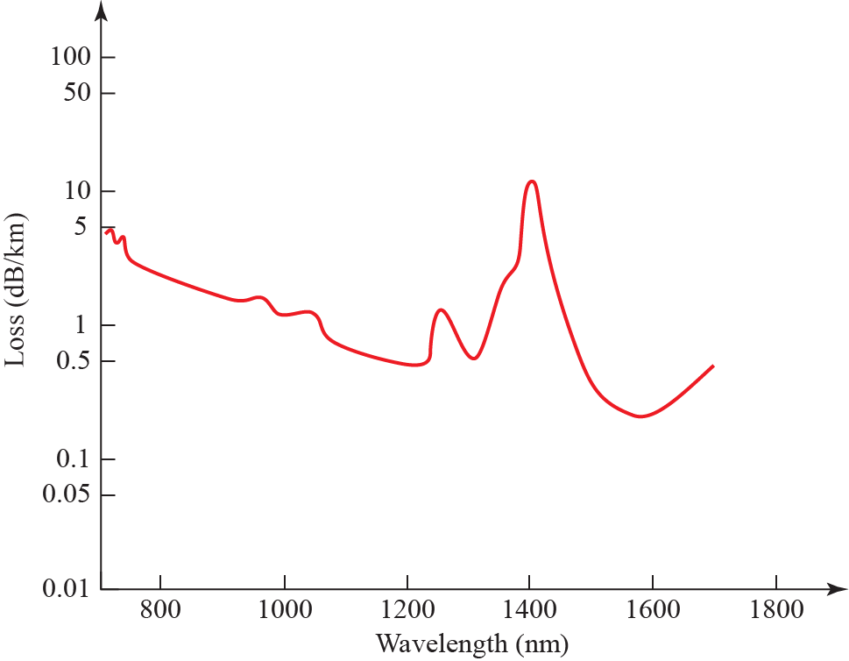
    7.2 Guided Media
Fig. 7.16 Optical fiber performance

Slide 19
    7.2 Guided Media
Advantage and Disadvantages of Optical Fiber
Advantages
  Higher bandwidth
  Less signal attenuation
  Immunity to electromagnetic interference
  Resistance to corrosive materials
  Light weight
  Greater immunity to tapping
Disadvantages
  Installation and maintenance
  Unidirectional light propagation
  Cost

Slide 20
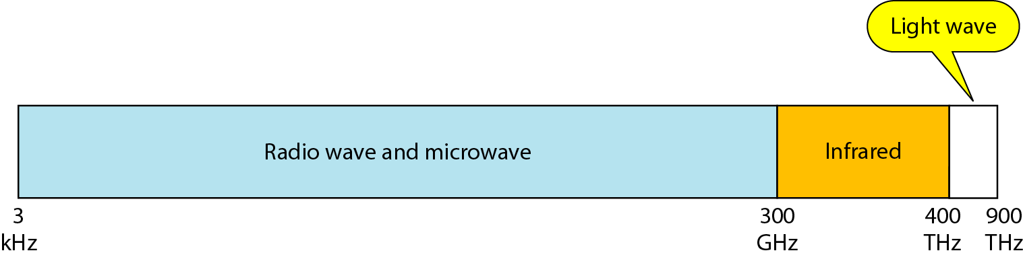
    7.3 Unguided Media
    7.3 Unguided Media
transport waves without using a physical conductor.
wireless communication
Fig. 7.17 Electromagnetic spectrum for wireless communication

Slide 21
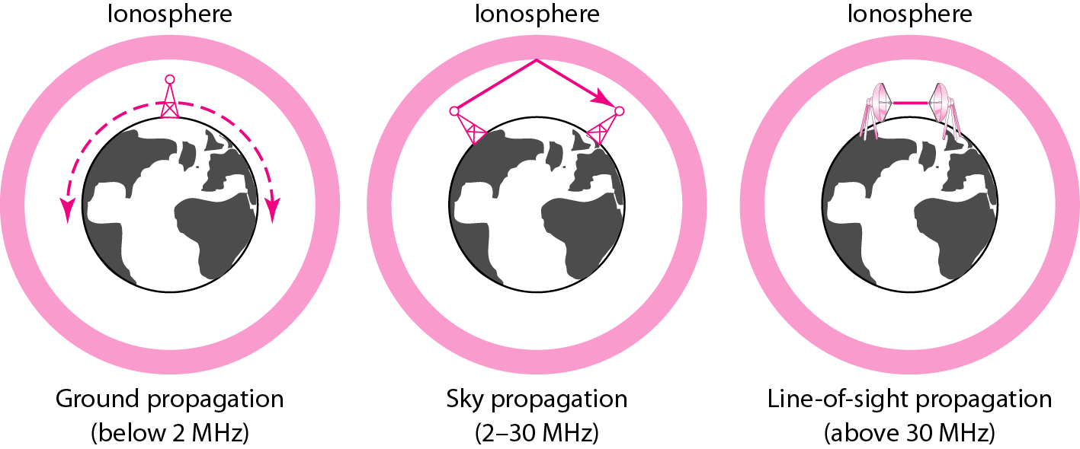
    7.3 Unguided Media
Fig. 7.18 Propagation methods

Slide 22
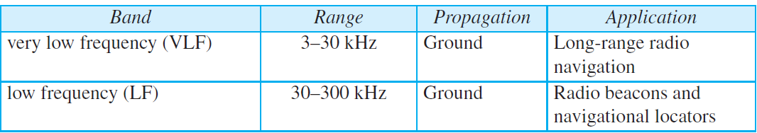
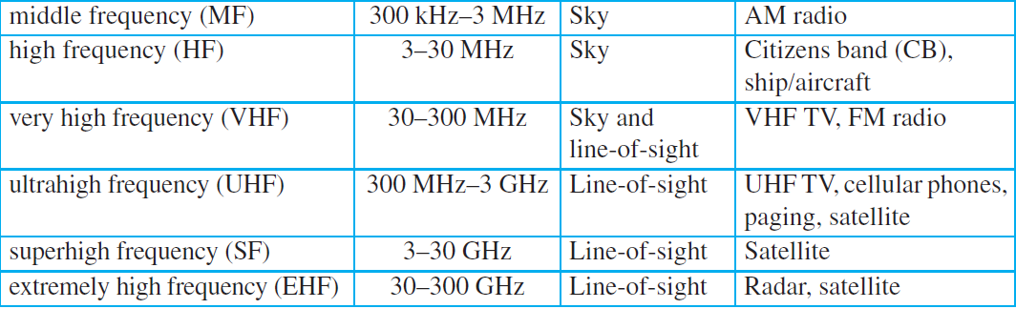
    7.3 Unguided Media
Table. 7.4 Bands

Slide 23

    7.3 Unguided Media
    7.3.1 Radio Waves
electromagnetic waves ranging in frequencies between 3 kHz and 1 GHz are normally called radio waves.
used for multicast communications.
Fig. 7.19 Omnidirectional antenna

Slide 24
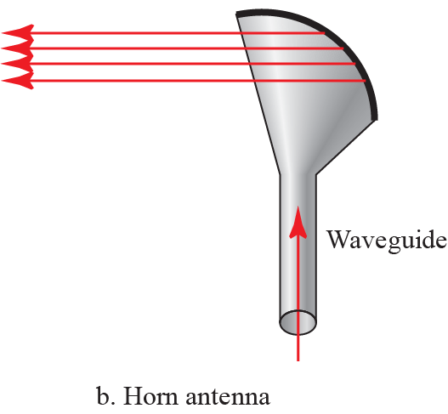
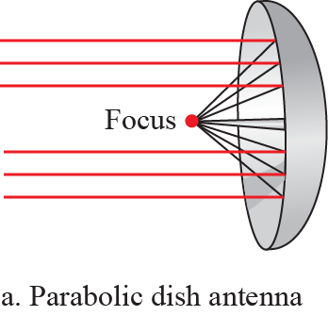
    7.3 Unguided Media
    7.3.2 Microwaves
electromagnetic waves having frequencies between 1 and 300 GHz are called microwaves.
used for unicast communications.
Fig. 7.20 Unidirectional antenna

Slide 25
    7.3 Unguided Media
    7.3.3 Infrared
with frequencies from 300 GHz to 400 THz (wavelengths from 1 mm to 770 nm)
used for short-range communication.
a short-range communication system in one room cannot be affected by another system in the next room.

Slide 26
    Homework
Homework
Read textbook pp. 207-230
Next Lecture
Chapter 8. Switching

